Slide 1
Module - V

Slide 2
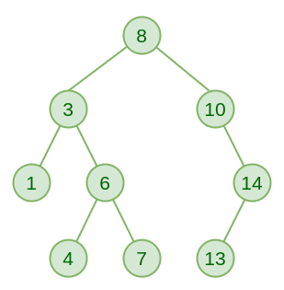
Breadth First Search (BFS)
The Breadth First Search (BFS) algorithm is used to search a graph data structure for a node that meets a set of criteria.
It starts at the root of the graph and visits all nodes at the current depth level before moving on to the nodes at the next depth level.
BFS : 8,3,10,1,6,14,4,7,13

Slide 3
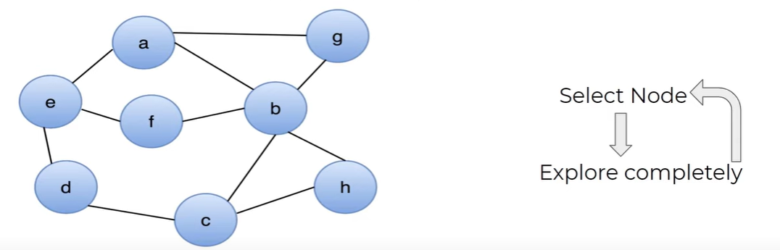
Breadth First Search (BFS)
One of the possible BFS : a e b g f d c h

Slide 4
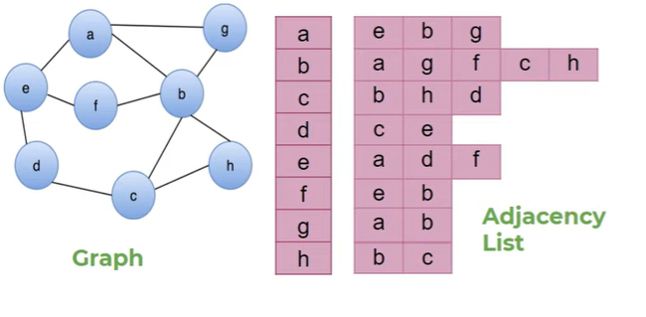
Breadth First Search (BFS)
Queue
Processing Node
e | b | g
a
Visited
a | e | b | g | f | d | c | h

Slide 5
Depth First Search (DFS)
Depth-first search is an algorithm for traversing or searching tree or graph data structures.
The algorithm starts at the root node (selecting some arbitrary node as the root node in the case of a graph) and explores as far as possible along each branch before backtracking.
DFS : 8,3,1,6,4,7,10,14,13

Slide 6
Depth First Search (DFS)
One of the possible DFS : a e d c b h g f

Slide 7
Depth First Search (DFS)
Stack
Dfs(e)
Dfs (a)
Visiting Array
a | b | c | d | e | f | g | h
T | F | F | F | T | F | F | F
Visited

Slide 8
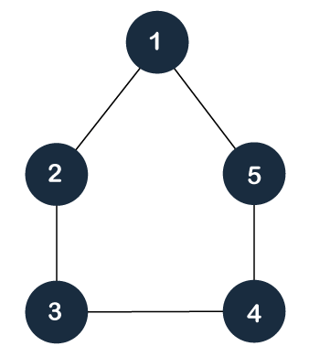
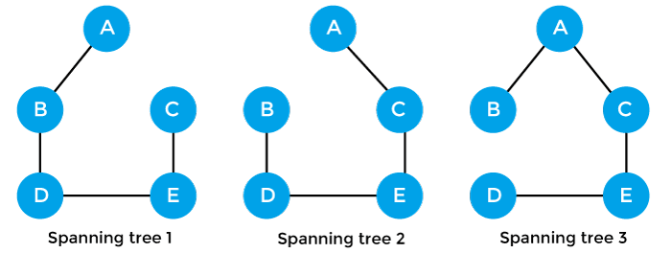
Spanning Tree
A spanning tree is defined as a tree-like subgraph of a connected, undirected graph that includes all the vertices of the graph
it is a subset of the edges of the graph that forms a tree (acyclic) where every node of the graph is a part of the tree.

Slide 9
Properties of a Spanning Tree
The number of vertices (V) in the graph and the spanning tree is the same.
There is a fixed number of edges in the spanning tree which is equal to one less than the total number of vertices ( E = V-1 ).
The spanning tree should not be disconnected, as in there should only be a single source of component, not more than that.
The spanning tree should be acyclic, which means there would not be any cycle in the tree.
The total cost (or weight) of the spanning tree is defined as the sum of the edge weights of all the edges of the spanning tree.
There can be many possible spanning trees for a graph.

Slide 10
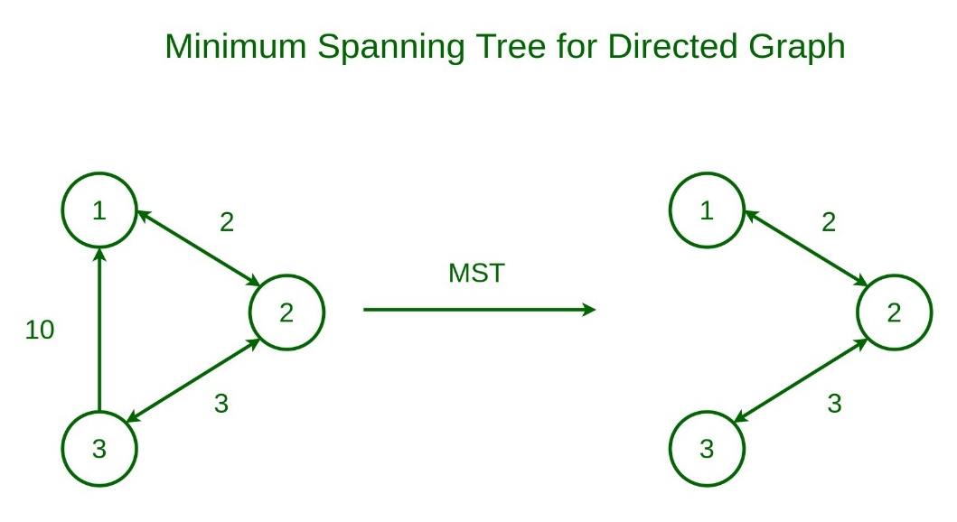
Minimum Spanning Tree
A minimum spanning tree (MST) is defined as a spanning tree that has the minimum weight among all the possible spanning trees.
The minimum spanning tree has all the properties of a spanning tree with an added constraint of having the minimum possible weights among all possible spanning trees. Like a spanning tree, there can also be many possible MSTs for a graph.

Slide 11
Minimum Spanning Tree
Prim’s Minimum Spanning Tree Algorithm
Kruskal’s Minimum Spanning Tree Algorithm
Prim’s Minimum Spanning Tree Algorithm:
It starts by selecting an arbitrary vertex and then adding it to the MST.
Then, it repeatedly checks for the minimum edge weight that connects one vertex of MST to another vertex that is not yet in the MST.
This process is continued until all the vertices are included in the MST.
Kruskal’s Minimum Spanning Tree Algorithm:
First, it sorts all the edges of the graph by their weights,
Then starts the iterations of finding the spanning tree.
At each iteration, the algorithm adds the next lowest-weight edge one by one, such that the edges picked until now does not form a cycle. continued until all the vertices are included in the MST

Slide 12
Prim’s Algorithm for Minimum Spanning Tree (MST)
The algorithm starts with an empty spanning tree.
The idea is to maintain two sets of vertices.
The first set contains the vertices already included in the MST, and the other set contains the vertices not yet included.
At every step, it considers all the edges that connect the two sets and picks the minimum weight edge from these edges.
After picking the edge, it moves the other endpoint of the edge to the set containing MST.

Slide 13
Algorithm
Step 1: Determine an arbitrary vertex as the starting vertex of the MST.
Step 2: Follow steps 3 to 5 till there are vertices that are not included in the MST (known as fringe vertex).
Step 3: Find edges connecting any tree vertex with the fringe vertices.
Step 4: Find the minimum among these edges.
Step 5: Add the chosen edge to the MST if it does not form any cycle.
Step 6: Return the MST and exit

Slide 14
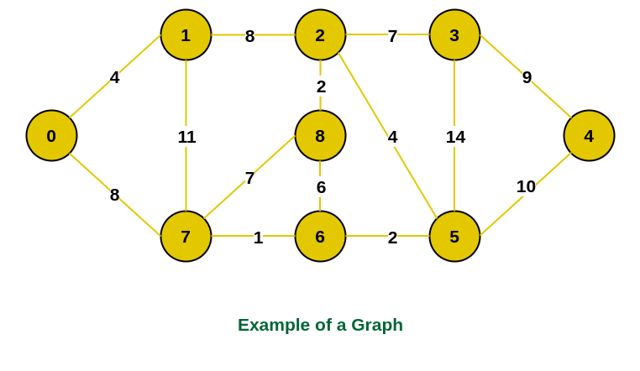
Prim’s Algorithm

Slide 15
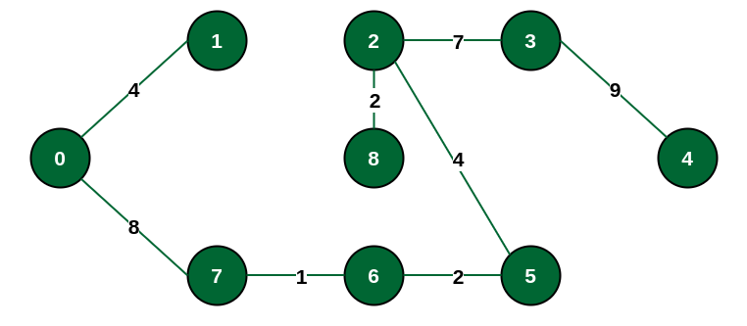
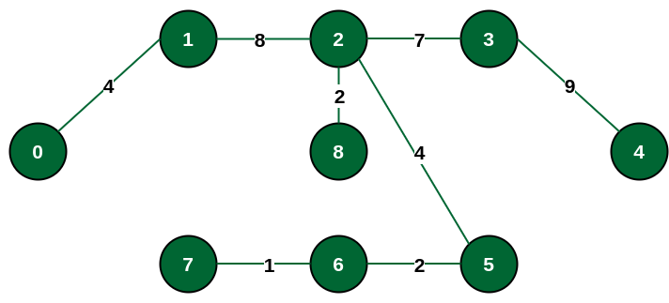
Prim’s Algorithm

Slide 16
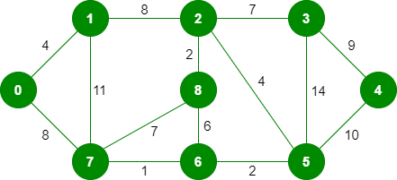
Kruskal’s Algorithm for Minimum Spanning Tree (MST)
Kruskal’s algorithm to find the minimum cost spanning tree uses the greedy approach. The Greedy Choice is to pick the smallest weight edge that does not cause a cycle in the MST constructed so far.

Slide 17
Kruskal’s Algorithm
Wight | 1 | 2 | 2 | 4 | 4 | 6 | 7 | 7 | 8 | 8 | 9 | 10 | 11 | 14
Source | 7 | 8 | 6 | 0 | 2 | 8 | 2 | 7 | 0 | 1 | 3 | 5 | 1 | 3
Destination | 6 | 2 | 5 | 1 | 5 | 6 | 3 | 8 | 7 | 2 | 4 | 4 | 7 | 5

Slide 18
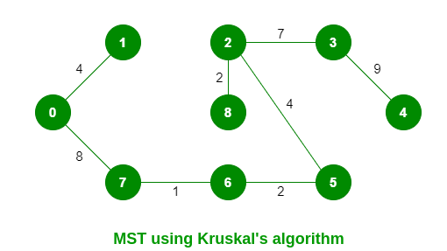
Kruskal’s Algorithm

Slide 19
Applications of Spanning Tree
Network design: Spanning trees can be used in network design to find the minimum number of connections required to connect all nodes. Minimum spanning trees, in particular, can help minimize the cost of the connections by selecting the cheapest edges.
Image processing: Spanning trees can be used in image processing to identify regions of similar intensity or color, which can be useful for segmentation and classification tasks.
Social network analysis: Spanning trees and minimum spanning trees can be used in social network analysis to identify important connections and relationships among individuals or groups.

Slide 20
Dijkstra's algorithm
Dijkstra's algorithm - is a solution to the single-source shortest path problem in graph theory.
Works on both directed and undirected graphs. However, all edges must have nonnegative weights.
Input: Weighted graph G={E,V} and source vertex v∈V, such that all edge weights are nonnegative
Output: Lengths of shortest paths (or the shortest paths themselves) from a given source vertex v∈V to all other vertices

Slide 21
Approach
The algorithm computes for each vertex u the distance to u from the start vertex v, that is, the weight of a shortest path between v and u.
the algorithm keeps track of the set of vertices for which the distance has been computed.
Every vertex has a label D associated with it. For any vertex u, D[u] stores an approximation of the distance between v and u. The algorithm will update a D[u] value when it finds a shorter path from v to u.
When a vertex u is added to the cloud, its label D[u] is equal to the actual (final) distance between the starting vertex v and vertex u.

Slide 22
Dijkstra pseudocode
Dijkstra(v1, v2):
for each vertex v: // Initialization
v's distance := infinity.
v's previous := none.
v1's distance := 0.
List := {all vertices}.
while List is not empty:
v := remove List vertex with minimum distance.
mark v as known.
for each unknown neighbor n of v:
dist := v's distance + edge (v, n)'s weight.
if dist is smaller than n's distance:
n's distance := dist.
n's previous := v.
reconstruct path from v2 back to v1,
following previous pointers.

Slide 23
Example: Initialization
Distance(source) = 0
0
∞
Distance (all vertices but source) = ∞
A
2
B
4
1
3
10
∞
C
2
D
2
E
∞
5
8
∞
4
6
F
1
G
∞
∞
Pick vertex in List with minimum distance.

Slide 24
Example: Update neighbors' distance
0
2
A
2
B
4
1
3
10
∞
C
2
D
2
E
∞
5
8
1
4
6
Distance(B) = 2
F
1
G
Distance(D) = 1
∞
∞

Slide 25
Example: Remove vertex with minimum distance
0
2
A
2
B
4
1
3
10
∞
C
2
D
2
E
∞
5
8
1
4
6
F
1
G
∞
∞
Pick vertex in List with minimum distance, i.e., D

Slide 26
Example: Update neighbors
0
2
A
2
B
4
1
3
10
3
C
2
D
2
E
3
5
8
1
4
6
Distance(C) = 1 + 2 = 3 Distance(E) = 1 + 2 = 3 Distance(F) = 1 + 8 = 9 Distance(G) = 1 + 4 = 5
F
1
G
9
5

Slide 27
Example: Continued...
Pick vertex in List with minimum distance (B) and update neighbors
0
2
A
2
B
4
1
3
10
3
C
2
D
2
E
3
5
8
1
4
6
Note : distance(D) not updated since D is already known and distance(E) not updated since it is larger than previously computed
F
1
G
9
5

Slide 28
Example: Continued...
Pick vertex List with minimum distance (E) and update neighbors
0
2
A
2
B
4
1
3
10
3
C
2
D
2
E
3
5
8
1
4
6
F
1
G
No updating
9
5

Slide 29
Example: Continued...
Pick vertex List with minimum distance (C) and update neighbors
0
2
A
2
B
4
1
3
10
3
C
2
D
2
E
3
5
8
1
4
6
Distance(F) = 3 + 5 = 8
F
1
G
8
5

Slide 30
Example: Continued...
Pick vertex List with minimum distance (G) and update neighbors
0
2
A
2
B
4
1
3
10
3
C
2
D
2
E
3
5
8
1
4
6
F
1
G
Previous distance
6
5
Distance(F) = min (8, 5+1) = 6

Slide 31
Example (end)
0
2
A
2
B
4
1
3
10
3
C
2
D
2
E
3
5
8
1
4
6
F
1
G
6
5
Pick vertex not in S with lowest cost (F) and update neighbors

Slide 32
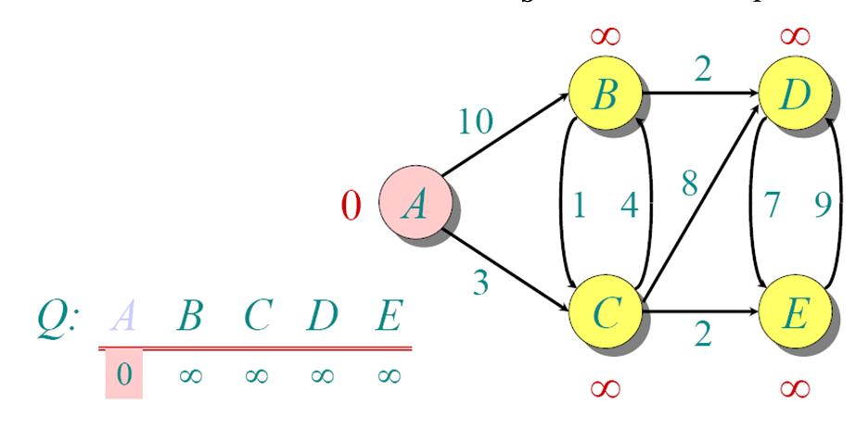
Another Example

Slide 33
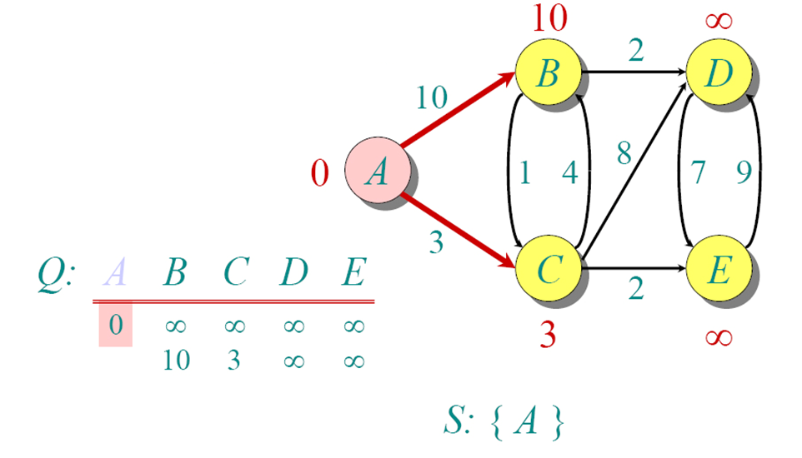
Another Example

Slide 34
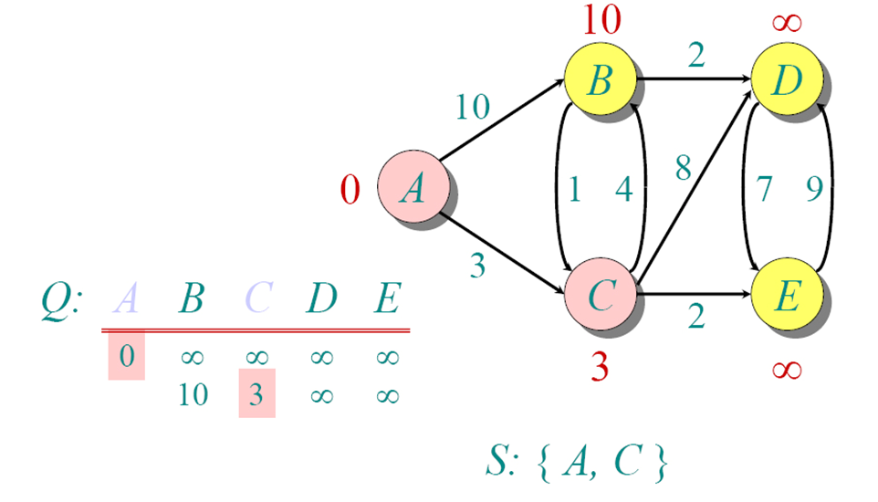
Another Example

Slide 35
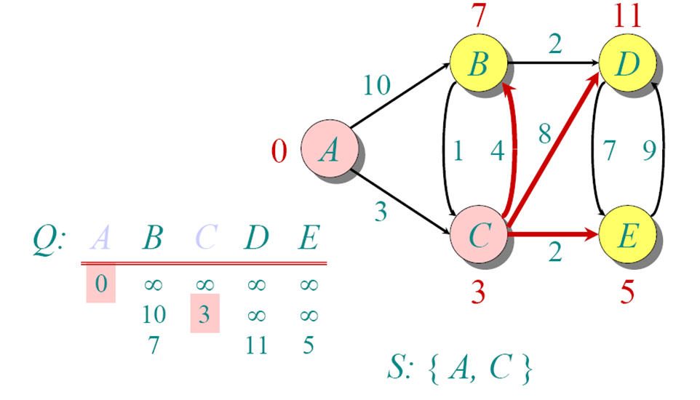
Another Example

Slide 36
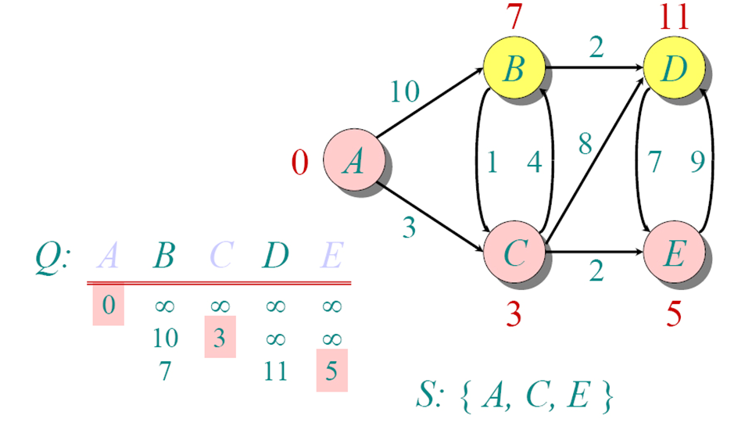
Another Example

Slide 37
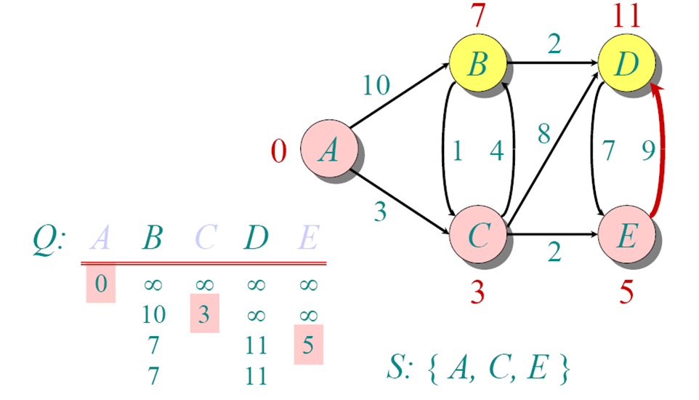
Another Example

Slide 38
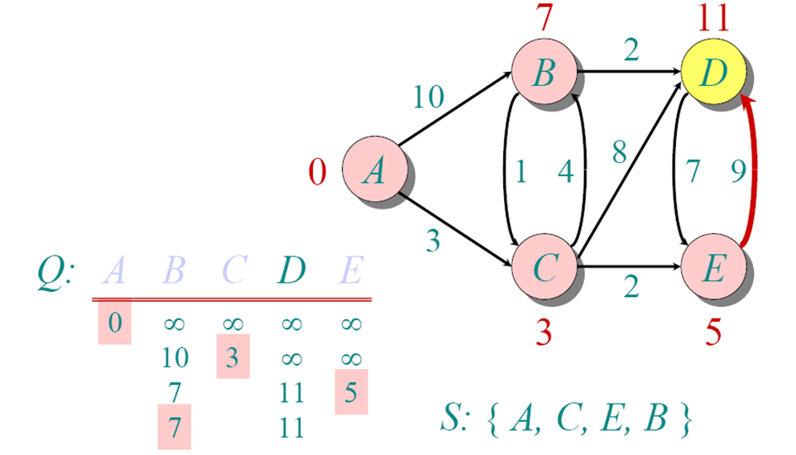
Another Example

Slide 39
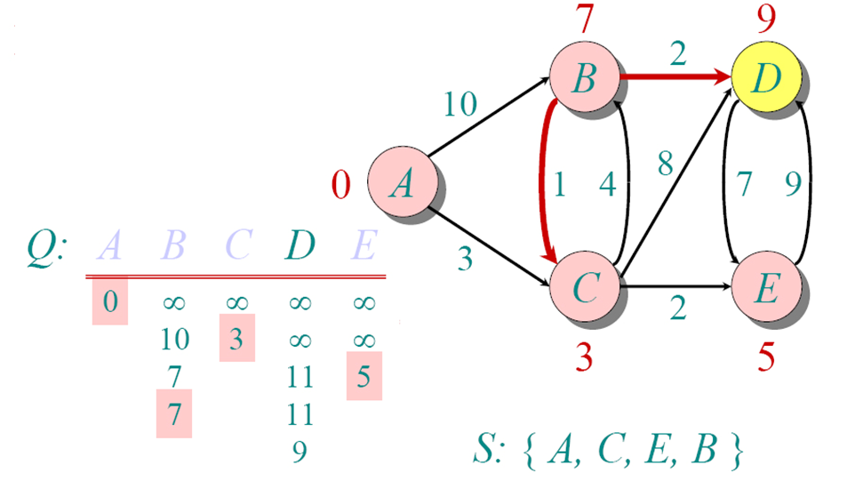
Another Example

Slide 40
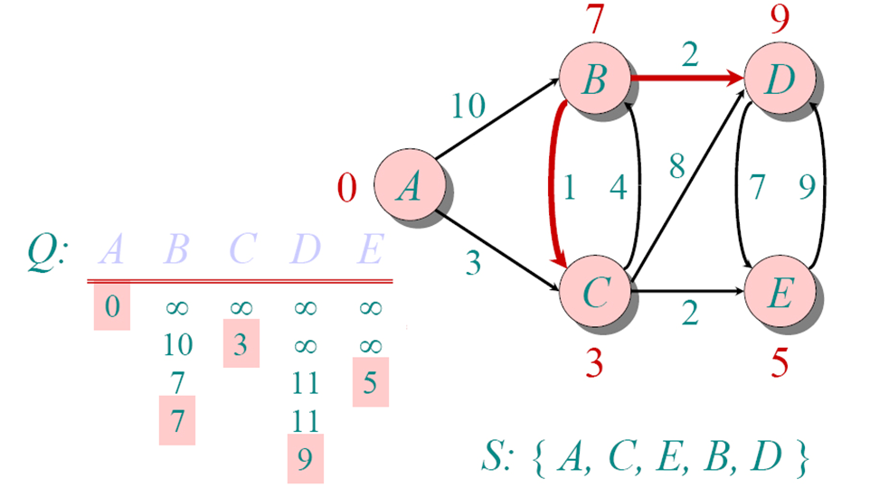
Another Example

Slide 41
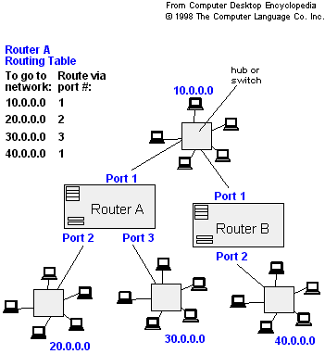
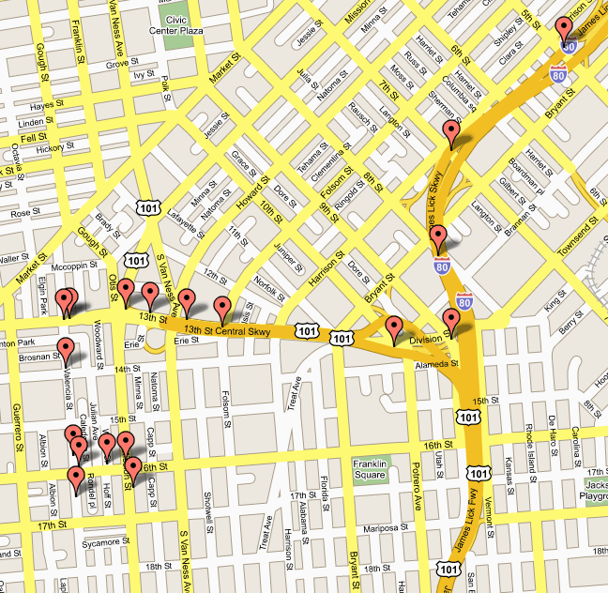
Applications
- Maps (Map Quest, Google Maps)
- Routing Systems

